Slide 1
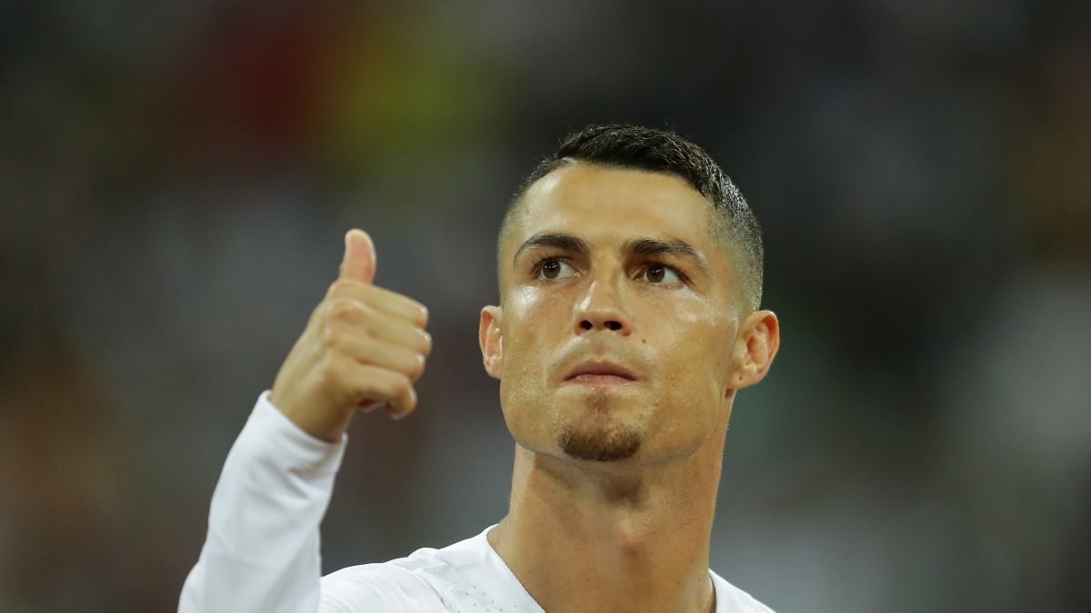
cristiano ronaldo
By ahmad Karimi y5

Slide 2
When he was born ?
CRISTIANO RONALDO WAS BORN ON THE 5th February 1985

Slide 3
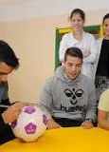
Where was he born ?
He was born in the Hospital Dr. Neilo Mendonsa , Funchal , Portugal

Slide 4
Christiano ronaldo’s childhood
Cristiano Ronaldo was born on 5 February 1985 in Madeira, Portugal, to Jose Dinis Aveiro and his wife Maria Dolores dos Santos Aveiro. His father was a gardener with the municipality while his mother worked as a cook. Ronaldo was the youngest child among four children; others being a son and two daughters

Slide 5
WHAT WAS HIS career ?
Born and raised on the Portuguese island of Madeira, Ronaldo was diagnosed with a racing heart at age 15. He underwent an operation to treat his condition, and began hissenior club career playing for Sporting CP, before signing with Manchester United at age 18 in 2003

Slide 6
QUOTES
“I'm living a dream I never want to wake up from.” ...
“I am not a perfectionist, but I like to feel that things are done well. ...
“Your love makes me strong, your hate makes me unstoppable.” ...
“Don Alfredo leaves us, but his memory will last forever in our hearts.

Slide 7
thank you

Slide 8
any questions ?

